Slide 1
Amazingg Umbrellas
Brejia Blocker
Carolyn Toure
Coi Clarke
Randall Oliver
John Wilson
Sharita garmon

Slide 2
Our Vision
CEO Brejia Blocker
Amazingg Umbrellas was born when CEO Brejia Blocker discovered an opportunity to customize umbrellas to be as unique as every student at SSU
Positivity, motivation, and encouragement to rainy days
Favorite clothing, favorite sports, pets, quotes, self-portraits and beyond

Slide 3
Mission
To provide convenience and customization
Deliver our product at an affordable price
Focus on customer loyalty and customer satisfaction
Become a household name

Slide 4
Target Market
Students on Savannah State University’s Campus
Savannah Residents
young adults from the ages of 18 to 25, later introducing children designs
Our focus is on a market that is actively expressing their personalities, beliefs, and values and wants to do so without constraints.

Slide 5
Competitors/ Competitive Edge
Savannah State Book Store
Wal-mart
Target
Innovation and Customization
Affordable price and creative designs

Slide 6
Strategic Options
Differentiation strategy
Recognize the need to be different
Seek to build customer loyalty
Offer discounts and specials
Pursue expansion opportunities

Slide 7
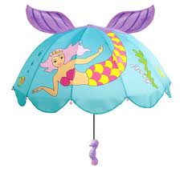
Our Product
Innovative
Variety
Personalized
High quality

Slide 8
S.W.O.T
Strengths: unique product, affordable, cutting edge background in business and marketing skills, business strategies
Weaknesses: unfamiliarity of market, customer base
Opportunities: seek expansion opportunities
Threats: relative new, unexpected costs, time

Slide 9
Market Analysis
Strong sales potential
Personal expression
Slim budgets

Slide 10
Market Strategy
“word of mouth”
Advertising visuals
Flyers, umbrellas
Web based promotion
Facebook, twitter, instagram
Sponsorship

Slide 11
Sales Strategy
Budgeting expenses and profit
Quality Control
Time management
Supply supervision

Slide 12
Milestones
Milestone Start Date End Date Budget
Manager Department
B. Blocker 11/4/2012 12/4/2012 $0 CEO
C. Clarke 11/4/2012 12/4/2012 $0 Public Relations
R. Oliver 11/4/2012 12/4/2012 $200 Manufacturing
C. Toure 11/4/2012 12/4/2012 $0 Customer Service
S. Garmon 11/4/2012 12/4/2012 $50 Mktg Strategy
J. Wilson 11/4/2012 12/4/2012 $0 Finances
Totals $250

Slide 13
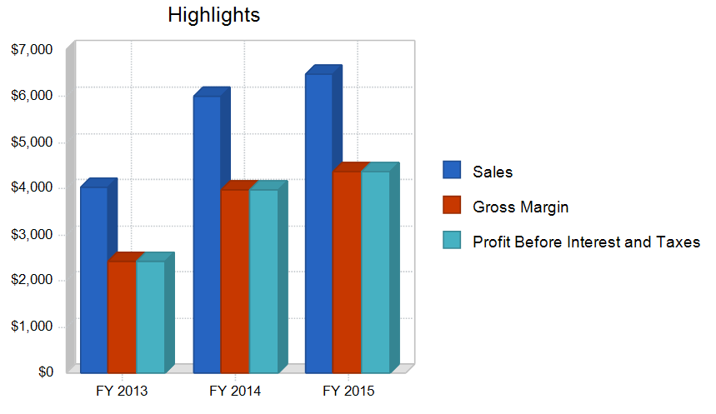
Financial Plan
Gage success growth
Monitor first month’s sales
Evaluate target market
Form a record of demand
$500 each contribution
Invest 100% into first year’s savings , after third year introduce compensation taking 50% of each month’s profit

Slide 14
Financials
FY 2013 FY 2014 FY 2015
Beginning Balance
Opening Balance Cash & Checking $3,000 $1,890 $5,870
Plus Money Received
Sales $4,050 $6,000 $6,500
Subtotal Money Received $4,050 $6,000 $6,500
Less Money Spent
Direct Costs
Direct Cost of Sales $1,620 $2,020 $2,120
Normal Operating Expenses
Payroll and Payroll Taxes, Benefits, Etc. $0 $0
Rent and Utilities $0 $0 $0
Sales and Marketing Expenses $0 $0 $0
Other Operating Expenses $0 $0 $0

Slide 15
Financial Continues
Other Outflows
Purchase of Assets $3,540 $0 $0
Subtotal Money Spent $5,160 $2,020 $2,120
Ending Balance
Ending Bal Cash & Checking $1,890 $5,870 $10,250
Profit Before Interest & Taxes
Sales $4,050 $6,000 $6,500
Less Cost of Sales ($1,620)($2,020)($2,120)
Gross Margin $2,430 $3,980 $4,380
Less Operating Expenses $0 $0 $0
Profit Before Interest & Taxes $2,430 $3,980 $4,380
Net Cash Flow ($1,110) $3,980 $4,380

Slide 16
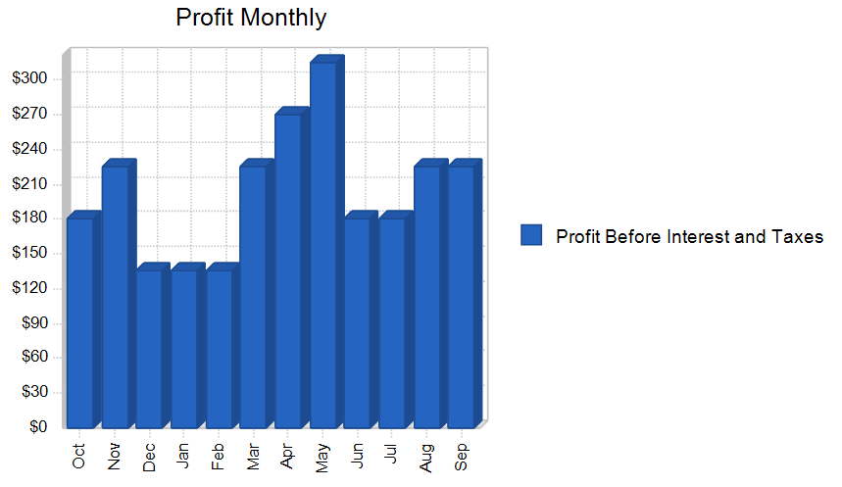
Profit Monthly

Slide 17
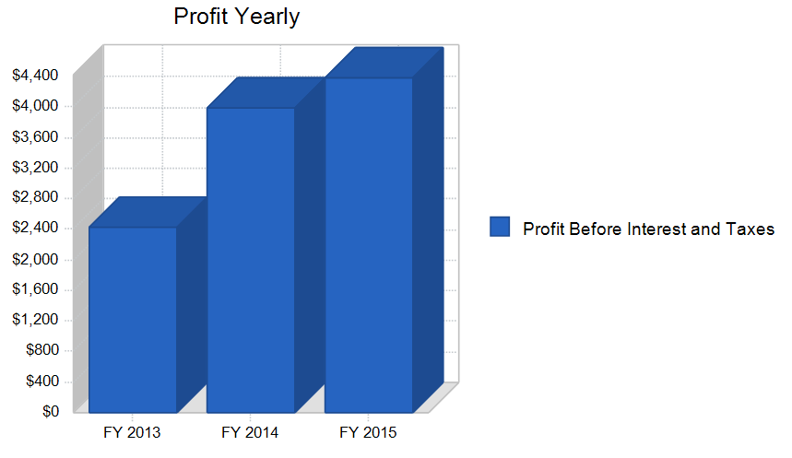
Profit Yearly

Slide 18
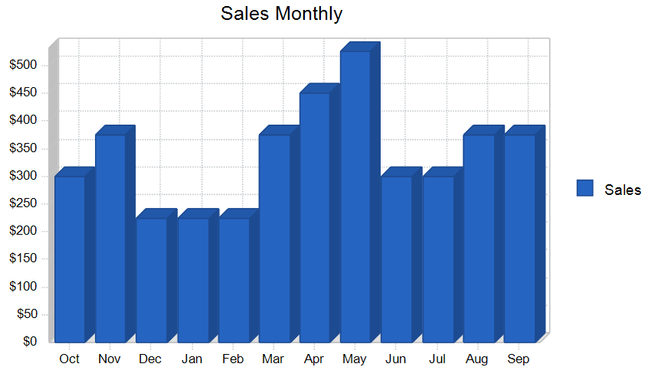
Sales Monthly

Slide 19
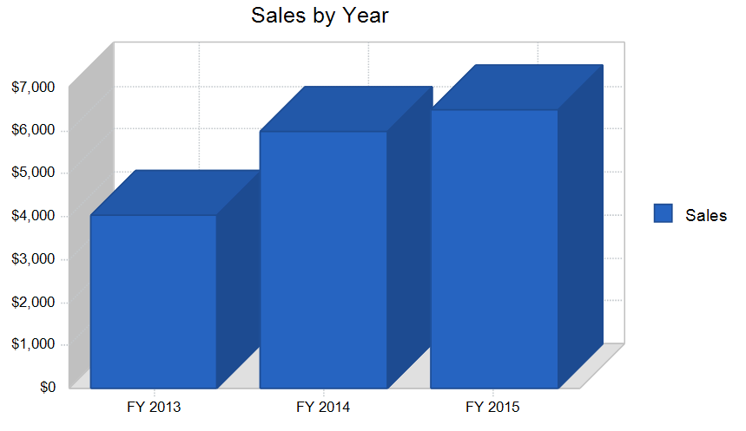
Sales by Year

Slide 20
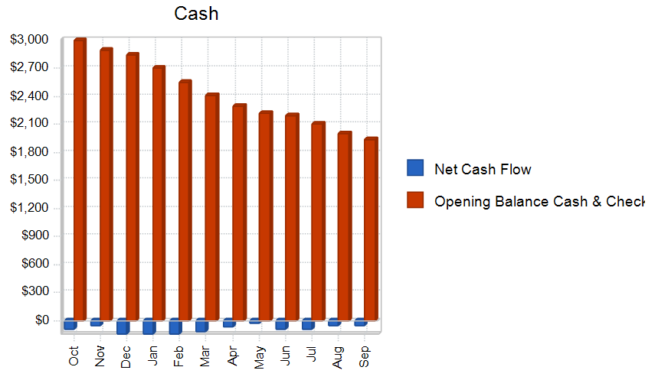
Company Currency

Slide 21
Product and Production Costs
Standard Umbrella $15
Extra designs will cost based on material
Wholesale Mart: $5 per unit/umbrella; $1 per umbrella sleeve
Operating supplies: $100 minimum each month

Slide 22
Why Buy From Us…
As a company we recognize the need to attract our target market by staying in touch with the world around us
We pride ourselves on customer service, in our eyes the customer is always right and we want to provide them with a product that they will enjoy

Slide 23
Q & A!!!

