Slide 1
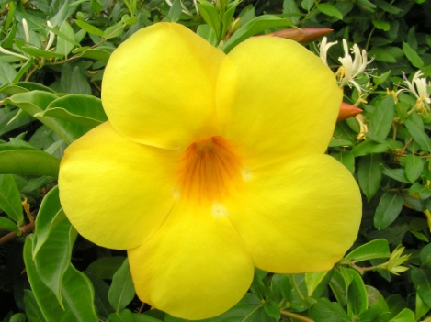
Luxurious Bloom Brush
“The Bloom of the Flower within”
Brejia’ Blocker

Slide 2
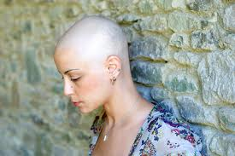
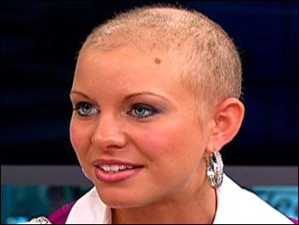
Social Problem
Hair loss and stress of cancer patients and individuals with alopecia disease

Slide 3
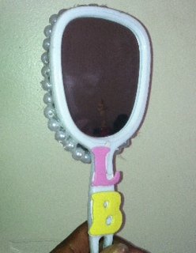
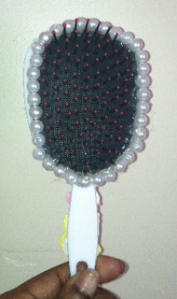
Social Venture
Product- a beauty kit including a paddle brush with a mirror, a hair growth stimulating formula, and make-up

Slide 4
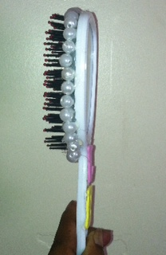
Product Design

Slide 5
Product Development
As the business expands, it will have a compartment opening consisting of efficient hair products, make-up, and the mirror will be inside of the brush.
The external design of the brush will be a yellow flower inside of a pink heart on the handle of the brush.
The initial brushes will have the design of the business initials and trademark in pink & yellow letters.

Slide 6
Mission and Purpose of LB
To enrich the beauty and confidence of cancer patients by providing beauty mechanisms and to reduce hair loss by providing hair growth stimulating products.
The brush and formula: Hair stimulation
Mirror: represents the beauty internally & externally
Make-up: beauty enhancement

Slide 7
Human Resources
Volunteers
Advertising and promotional team
Local beauty supply stores
Local hospitals
Manufacturing company

Slide 8
Opportunity
To give an innovative way of catering to cancer patients and individuals with alopecia.
Hair growth of these individuals will give them something positive to look forward to while uplifting them through appearance improvement.

Slide 9
Fundraising Strategy
A variety of private and public sources and will be raised through the efforts of volunteers and staff.
Charity and Donations
Win, keep, and uplift strategy

Slide 10
Financial Plan
Start-up Cost: $5,000
Production Cost: $25/ unit
Selling Price: $30/ unit
First month sales target: 100 units
First month expenses: $2500
First month profit: $3000
First month revenue: $500
ROI: $100 each month after first 3 months

Slide 12
Financial Plan
Year 1: Total annual profit will be $6,000. I will invest $100 each month after 3 months which leaves me with a profit of $5,100.
Year 2: Total profit will be $6,000. I will invest each month leaving my account with $4, 800 profits.
Year 3: Total profit will be $6,000. I will not invest so my profit will remain $6,000.

Slide 14
Market Analysis
Trends that I see in the community that I live revolve around beauty and improving ones appearance no matter the cost
There are any cases of alopecia which individuals are losing hair caused by poor condition and/or stress
My target audience is female cancer patients coping with hair loss due to cancer and alopecia
My target market could be local hospitals and beauty supply stores, who can use my product

Slide 15
Similar Business
Wondew Company has a similar product as I do. If you visit their website, they provide brushes with mirrors on the back. http://wondew.com/PIC/2013257534065277.jpg
My Product
A compartment inside of the brush for make-up
Hair growth formula that the customer can also store inside.
For a social problem that needs attention.
They are a commercial enterprise while my purpose for my social venture is to alleviate a social issue.

Slide 16
Market Strategy
Social media networks such as Facebook, Twitter and Instagram to promote awareness of the social issue and my solution/ product.
I will host different events about the issue to get investors.
provide promotional flyers for local beauty supply stores.

Slide 17
Exit Strategy
If my social venture fails or if I no longer want to keep it, I will donate the brush kits to cancer patients at the local hospitals and to the individuals who need them.

Slide 18
Thanks for listening!!!
Support the cause!!

